Slide 1

Forensic Investigation
Name
Institutional Affiliation

Slide 2
Introduction
Email stands for electronic mail
Email clients allow individuals create and interact with emails from each computer users
Email clients can be web-based or an application on a computer
Email works through a number of steps
Notes:
Communication of people via email is made possible by the servers of both the sender and the recipient. The simple mail transfer protocol helps in capturing and determining the correct address of the recipient for any message sent through email. This enables that confusion is not created by emails ending up in wrong email addresses. The email client can be either a website or an application of the email installed and running on the computer

Slide 3
Protocols used in email systems
Internet mail access protocol
Post office protocol
Simple mail transfer protocol
Notes:
To begin with, the internet mail access protocol is utilized while receiving an email. In this case, the emails are present in the server as well as cannot be downloaded to the user’s mail box and deleted from the server (Interserver, 2018). The post office protocol is employed for incoming emails. The main deviation with the two protocols is that POP downloads the entire email into the local computer as well as deletes data on the server once it is downloaded. Lastly, the simple mail transfer is used to send emails.

Slide 4
How the Sending and Receiving of Email Works
Email communication begins with the composition of a message
Uploading email text and attachments to the SMTP
SMTP server communication with the DNS
Download of all new messages
Notes:
Email communications begins with the composition of a message which is done by the sender using an email application or on the web version of the mail client. The main composition is simply writing the message and the sender may include attachments to go together with the message types. When the sender finishes with the composition, he or she sends the message. At that moment, the message is uploaded to the machine that handles the whole email communication from the sender to the receiver, also known as the simple mail transfer protocol server (Interserver, 2018). This server screens and tries to locate the sever of the receiving email address so as o complete the transfer of the message from the sender to the recipient.

Slide 5
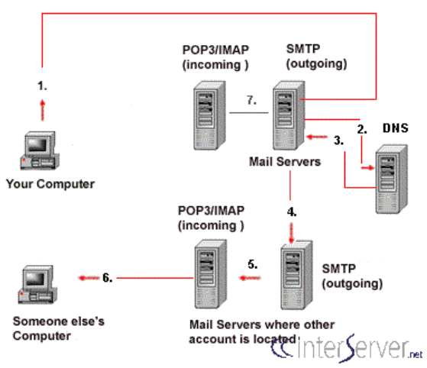
Graphic depiction
Notes:
The graphic depiction indicates the way email works from the sender to the receiver. In particular, the diagram explains the path that email takes from one’s computer to the intended recipient (Interserver, 2018). It is important to comprehend that there exist many logical machines in the email delivery process.

Slide 6
Types of Information forensic investigations attempt to uncover
Communication through email is gaining popularity over the internet
Forensic email investigators uncover substantial information
They uncover the messages and communication between the sender and the recipient
They uncover IP address of the author’s internet provider
Notes:
Forensic email investigators attempt to uncover substantial information through email. It is important to note that email store many information including attachments and messages shared between the author and the recipient (Tajuddin & Manaf, 2015). Some of the information uncovered include IP address of the sender’s internet provider, message ID, as well as deleted files.

Slide 7
Uncovered Information
Forensic email investigators use the email to uncover important information between the author and the recipient
Forensic email investigators recover deleted files
Uncover internet history as well as emails
Create synergy
Notes:
To begin with, forensic email investigators can recover deleted files. The reason is that most deleted files are located somewhere on the hard drive. Therefore, using programmed computer forensic software, a trained forensic investigator uncovers these deleted files as well as identify the content of the deleted files (Helfand, 2016). On the same note, one can uncover internet history as well as emails. Forensic email investigators unearth internet search history as well as previously sent and received emails. Additionally, they assist in other areas of an investigation such as creating synergy.

Slide 8
Uncovered Information
Forensic email investigators uncover information about fraud
They recover a file’s metadata such as last written and last accessed dates
They can recover incriminating email
They can reveal clues that can show how perpetrators of fraud planned for the process
Notes:
It is important to note that forensic email investigators work with forensic accountants to provide specific keywords to search for a hard drive and this saves time as well as efforts. In this case, they can reveal clues that forensic accountants can employ to further investigation (Tajuddin & Manaf, 2015). For instance, in case a financial statement fraud is committed, there might be emails that explain the way the perpetrators planned on committing the fraud. Therefore, the aforementioned synergic correlation is important to solve various types of fraud.

Slide 9
Conclusion
Forensic email investigators can recover important information from an email
For example, they can recover deleted files
Uncover internet history and emails
Create synergy
Notes:
Overall, forensic email investigators are important aspects in determining fraud in a particular organization. These individuals play a role in uncovering vital information that show the way the perpetrators organized for a fraud committed. They recover deleted files as well as uncover internet history and emails that give substantial data about a fraud committed.

Slide 10
References
Helfand, A. (2016). Computer forensics: an important tool for uncovering fraud.. Bond Beebe Accountants and Advisory. Retrieved from http://www.bbcpa.com/computer-forensics-an-important-tool-for-uncovering-fraud/
Interserver. (2018). How emails work – step and explanation. Interserver.
Tajuddin, T. B., & Manaf, A. A. (2015, October). Forensic investigation and analysis on digital evidence discovery through physical acquisition on smartphone. In 2015 World Congress on Internet Security (WorldCIS) (pp. 132-138). IEEE.

